Slide 1
Update on the “December Revolution Rehabilitation Centre Project”
Mr. Wail Ahmed, Consultant in Spinal Injuries
SSNR Secretary General
Member of SDU UK Rehabilitation Project Sub-committee
Former SDU UK Membership Secretary 2019 – 2020
4.2.2023

Slide 2
The December Revolution Centre for Rehabilitation of Traumatic Spinal Cord and Brain Injuries
Project agreed by the SDU UK EC in Jan 2020
Money allocated from Manchester Group Committee Donations = £173, 000
£10,000 was paid towards treatment of revolution injured victims post-Military Coup in October 2021 (Paid to Unified Doctors’ Office and Hadhreen)
The remaining £163,000 was allocated for the Rehab Project
MoU with KTH agreed last March 2022 to develop KTH Hyperacute Rehabilitation Centre
Prior permission was sought from Soba University Hospital because of MoU signed in 2020
Money spent on Equipment purchase to KTH Hyperacute Rehab Centre is £106,000 (118,000) Euros
Transfer of 50 % (£53,500 i.e., 60,500 Euros) was completed on 20/1/2023
EDD is in 2 months
Remainder money = £57,000

Slide 5
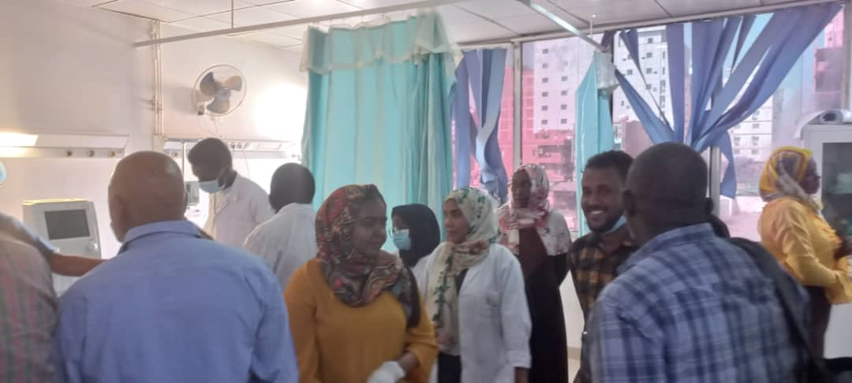
Photos from KTH Rehab Centre

Slide 6
Photos from KTH Rehab Centre

Slide 7
Future Plans
To complete the transaction of the KTH Rehab Unit equipment
To organize official opening ceremony of the KTH Hyperacute Rehab Centre with KTH in the next few months
To invest the remaining £57,000 in the Tertiary Rehabilitation Unit in Soba University Hospital

